Slide 1

Madanapalle Institute of Technology and Science
Department of DATA SCIENCE
CUSTOMER CHURN PREDICTION
Team Members:
S.Gowri Harshitha – 21691A3227
G.Nashrath – 21691A3263
R.Nithish Kumar Reddy – 21691A3266
Guided By:
Dr. S.Kusuma , Ph.D
Head of The Department

Slide 2
ABSTRACT
Customer churn is the process of estimating the number of customers who want to cancel (subscription) to the services or products they receive in many ways, especially in sectors such as communication, money management and insurance, and determining the necessary operational steps to prevent this situations. This uses various machine learning algorithms used to create churn models that help telecom operators to predict customers who are likely to leave. This hepls to identify the factors that influence customers and construct an efficient model, which is used to predict and analyze data with visualization results.

Slide 3
INTRODUCTION
Customer churn, also known as customer attrition, refers to the phenomenon where customers discontinue their relationship with a company, leading to lost revenue and decreased market share. In industries ranging from telecommunications and banking to e-commerce and subscription based services, the ability to anticipate and mitigate churn can significantly impact the bottom line and enhance customer retention strategies. By leveraging historical customer data, including demographic information, transactional history, and engagement metrics, machine learning models can identify patterns and indicators associated with customer churn.

Slide 4
A. Existing System Customer churn prediction is done using variety of techniques, including data mining, machine learning, and hybrid technologies. These techniques enable and support companies in identifying, predicting, and retaining churn customers. But the study shows that reducing the data increases the accuracy of the decision tree. B. Proposed System In this system, we use various algorithms like Random Forest, Logistic Regression, XG Boost Light GBM classifier to find accurate values and which helps us to predict the churn of the customer Here we implement the model by having a dataset that is trained and tested, which gives the best results.

Slide 5
Software Requirements: Programming Language : Python Machine Learning Algorithms: XGB Classifier, Light GBM Classifier, Random Forest Classifier, and Decision Tree Classifier, Logistic Regression, Gaussian NB.

Slide 6
Literature survey
Customer churn prediction in telecommunication industry using deep learning
SW Fujo, S Subramanian… - Information Sciences …, 2022 - digitalcommons.aaru.edu.jo
This is implemented based on a supervised classification deep learning technique to predict if the customer is going to churn or not in the telecom industry. Beside implemented the most common four ML technique LR, NB, KNN, XG Boost in CCP, to compare our proposed model with them. The method includes six main phases: data collection, datapre-processing, feature engineering, random over sampling, modelling , and evaluation.

Slide 7
Distributed model for customer churn prediction using convolutional neural network MU Tariq, M Babar, M Poulin… - Journal of Modelling in …, 2022 - emerald.com The proposed model uses the 2-D convolutional neural network (CNN; a technique of deep learning). The proposed model is a layered architecture that comprises two different phases that are data load and preprocessing layer and 2-D CNN layer. In addition, the Apache Spark parallel and distributed framework is used to process the data in a parallel environment. Training data is captured from Kaggle by using Telco Customer Churn.

Slide 8
CUSTOMER CHURN PREDICTION WITH HYBRID RESAMPLING AND ENSEMBLE LEARNING.T Kimura - Journal of Management Information & Decision …, 2022 - researchgate.net This study will develop classification models for customer churn prediction as a binary classification problem. In addition to traditional classification algorithms, novel ensemble methods will be used. Since the dataset is imbalanced, this study uses resampling methods to rebalance the dataset. The novelty of this study is the combined use of ensemble classification methods and hybrid resampling. This study covers the first four phases that will be implemented by Python(Dataset, Data Preprocessing, Data Partitioning, Resampling Method)

Slide 9
Artificial intelligence based customer churn prediction model for business marketsJ Faritha Banu, S Neelakandan, BT Geetha… - Computational …, 2022 - hindawi.com An effective AICCP-TBM model is built in this study to determine churned/non-churned clients in the telecommunications sector. The AICCP-TBM model is intended to increase churn detection while requiring low computational complexity.

Slide 10
Extreme gradient boosting trees with efficient Bayesian optimization for profit-driven customer churn prediction Z Liu, P Jiang, KW De Bock, J Wang, L Zhang… - … Forecasting and Social …, 2024 – Elsevie This study proposes BO-XGBT, a new profit-driven classifier for CCP based on XGBT and BO of hyperparameters. Three experiments are conducted using eight CCP datasets obtained from multiple industries. From the experiments, we found that the profitability of the proposed BO-XGBT is significantly better than that of other benchmark models with higher EMPC values, which verifies the superiority of the proposed BO-XGBT in providing profit maximization prediction results.

Slide 11
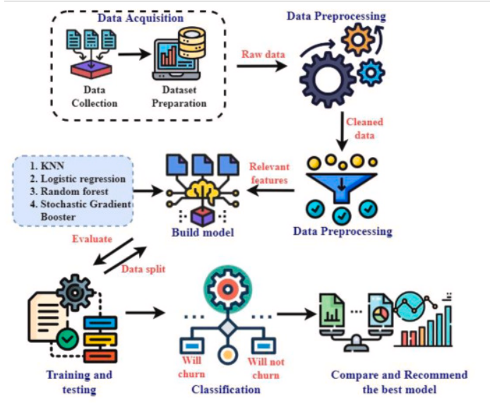
Architecture Diagram

Slide 12
Module List:
Data Collection:
The data was collected from a Kaggle website. The customer churn table contains information on all 7,043 customers at a telecommunications company in California. Each record represents one customer and contains details about demographics, location, tenure, subscription services, status for the quarter (joined, stayed or churned), and more.
Exploratory Data Analysis (EDA):
In the EDA phase, we explored the data through various statistical and visual perspectives. We analyzed the distribution of variables, checked for missing values, and identified outliers. We also performed feature engineering to extract relevant features and removed irrelevant features. We also analyzed the correlation between variables to avoid multicollinearity issues.

Slide 13
Feature Engineering:
Feature engineering for customer churn prediction involves the process of selecting, creating, and transforming raw data into meaningful features that capture relevant aspects of customer behaviour, interactions, and demographics. These features serve as input variables for machine learning models, enabling them to identify patterns and indicators associated with churn.
Model Selection:
We experimented with several machine learning models, including XGB Classifier, Light GBM Classifier, Random Forest Classifier, and Decision Tree Classifier, Logistic Regression, Gaussian NB. We used a V-fold cross-validation technique to evaluate the performance of each model based on accuracy, precision, recall, and F1 score. Based on the evaluation results, we selected the top-performing models for further analysis.

Slide 14
LightGBM classifier: LightGBM, short for Light Gradient Boosting Machine, is a powerful machine learning library primarily designed for boosting decision trees. It’s known for its efficiency, speed, and scalability, making it popular in various data science and machine learning applications. LightGBM implements a gradient boosting framework that optimizes the traditional gradient boosting algorithm. It has highest accuracy than XgBoost algorithm.
Model Evaluation:
In the model evaluation step, we use various metrics to evaluate the performance of training model. First, we calculated the accuracy score to determine the proportion of correctly classified instances out of all instances. However, accuracy alone is not always the best metric for evaluating classifier models, especially when the dataset is imbalanced. Therefore, we also calculated the F1-score, which considers both precision and recall, to evaluate the overall performance of the models. We also used a confusion matrix to visualize the performance of the models.

Slide 15
Future Work and Enhancement
The following study directions are suggested for the future:
To improve performance, conducting experiments on large-scale datasets and consider expanding the dataset to include varied domains.
The following study directions are suggested for the future: (i) To improve performance, researchers should conduct experiments on large-scale datasets and consider expanding the dataset to include varied domains.
Future research should look into Bagging Classifier approaches and other deep neural network models for predicting customer churn.

Slide 16
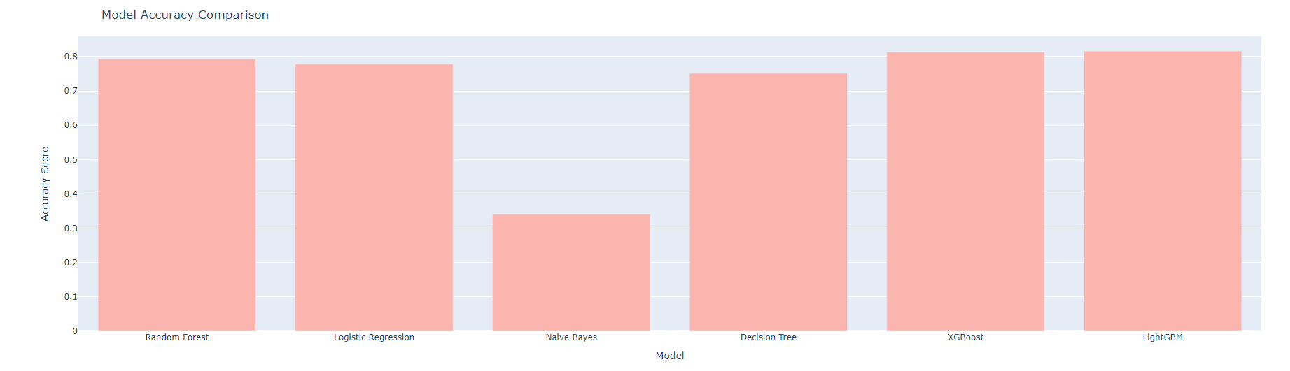
Conclusion
In conclusion, using LightGBM as a classifier for customer churn prediction offers a robust, efficient solution and high performance. By innovative optimization techniques, LightGBM can effectively handle large datasets, extract meaningful insights, and generate accurate predictions regarding customer churn. Its speed, scalability, and ability to handle high-dimensional data make it a valuable tool for organizations seeking to identify and address factors contributing to customer turnover.

Slide 17


